Slide 1
SOCIAL MEDIA WEBSITE Using JAVASCRIPT / HTML / CSS / REACT.JS/ FIREBASE
SUBMITTED BY: AYUSH KARN (2K19/CO/454)
SONU K KUSHWAHA(2K19/CO/383)
Submitted to: Mr. Manoj Sethi (DTU)

Slide 2
Introduction
Social Media plays a crucial role in connecting people and developing relationships, not only with key influencers and journalists covering your company's sector, but also provides a great opportunity to establish customer service by gathering input, answering questions and listening to their feedback.
In this project we have tried to make a social media type of website. In this website we have used React.JS, HTML, CSS for Front end Development and Firebase is used as the Backend for the project.
Following are the functionality that is provided in our project:
• Sign Up
• Log In and Log Out
• Posting a Social Media Post
• Add Caption to the Post
• Comment on a Post
• Firebase Authentication
• Interactive Interface
• Posting Your Fleet

Slide 3

Chapter 1.2: Brief Intro of all the API’s and components used (description)
HTML5
CSS3
JavaScript
Hypertext Markup Language is the standard markup language for documents designed to be displayed in a web browser. It can be assisted by technologies such as Cascading Style Sheets and scripting languages such as JavaScript
Cascading Style Sheets is a style sheet language used for describing the presentation of a document written in a markup language such as HTML. CSS is a cornerstone technology of the World Wide Web, alongside HTML and JavaScript
JavaScript, often abbreviated as JS, is a programming language that conforms to the ECMAScript specification. JavaScript is high-level, often just-in-time compiled, and multi-paradigm. It has curly-bracket syntax, dynamic typing, prototype-based object-orientation, and first-class functions

Slide 4



Chapter 1.2: Brief Intro of all the API’s and components used (description)
React.js
Node.js
FireBase
React is an open-source, front end, JavaScript library for building user interfaces or UI components. It is maintained by Facebook and a community of individual developers and companies. I have used react.js for writing my program. In react we have to write code in JSX format and later it gets converted to respective JavaScript by Babel Compiler
Node.js is an open-source, cross-platform, back-end, JavaScript runtime environment that executes JavaScript code outside a web browser. I have used node.js for creating a runtime environment for my project
Firebase is a platform developed by Google for creating mobile and web applications. It was originally an independent company founded in 2011. In 2014, Google acquired the platform and it is now their flagship offering for app development. I have used Firebase in this project for hosting my website and I am planning to use the database feature of Firebase in future for maintaining the database for my app

Slide 5
Innovative Component (USE OF FIREBASE as our DATABSE)
Authentication
.
Firebase Authentication provides backend services, easy-to-use SDKs, and out-of-the-box user interface libraries to authenticate users of your application. Normally, what takes months to build i.e. authentication. We can do it in less than 10 lines of code using FIREBASE
Firebase Database Query
Firebase has simplified the process of retrieving specific database data through queries. Queries are created by chaining one or more filtering methods
1
2
Firebase Realtime Database
Realtime Database is essentially a NoSQL cloud-storage that can be connected with the application to provide real time access to the data across different platforms. One of the advantages is that the database can work offline, caching the data in device memory, and after reconnecting to the internet, synchronizing it.
4
Cloud Firestore
Cloud Firestore is another cloud-hosted real-time NoSQL database. Unlike Firebase Realtime Database, Cloud Firestore is designed for enterprise use, which entails scalability, complex data models, and advanced querying options. There are SDKs for working with server-side code of both databases. These are available for Python, Node.js, Golang, Ruby, PHP, Java, .NET, and C#.
3
Google Analytics
Google Analytics comes first as it’s a well-known tool integrated into Firebase platform. Google Analytics provides valuable metrics about your user retention, user engagement rates, or any other type of user behavior data. In terms of Firebase, the reporting capabilities are unlimited and free. You can choose which events to track, and integrate it with analytical partners that names 52 companies on the integration page.
Cloud Storage
Cloud Storage is basically a Google Cloud for in-app user generated content, like photo, audio, or video files.
6
5

Slide 6
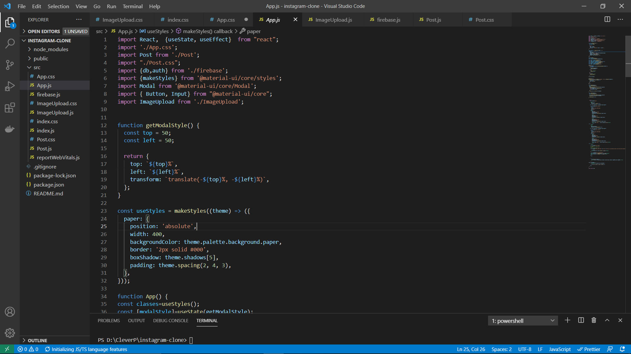
Work Done TILL 1ST review
Worked on the front- end
Place your screenshot here
We started learning about Google’s Firebase.
All the features that firebase offers were briefly
Learned by us. Then we started working on the
Front end part of the website.
Some snapshot of that is given on the side

Slide 7
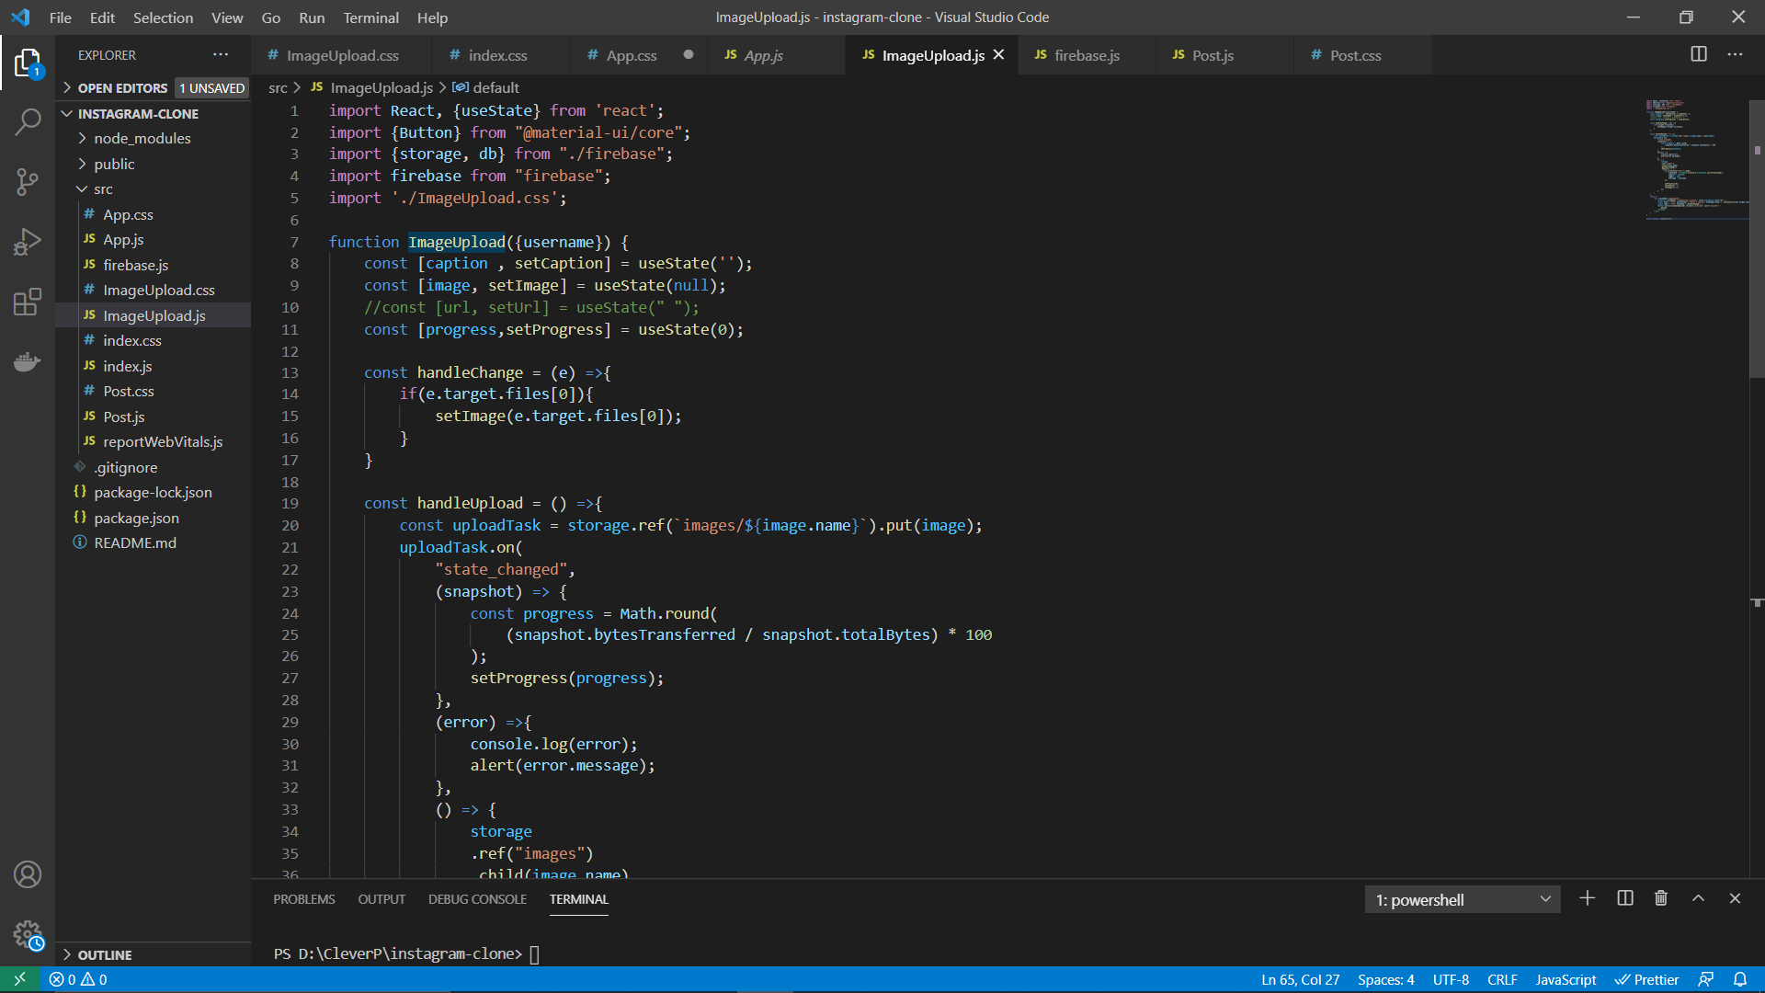
Work Done TILL 1ST review
Worked on the front- end
Place your screenshot here
We started learning about Google’s Firebase.
All the features that firebase offers were briefly
Learned by us. Then we started working on the
Front end part of the website.
We had completed the login logout functionality.
We also decided the layout of the database and
things we needed to keep inside our database
during the first review.
Some snapshot of that is given on the side

Slide 8
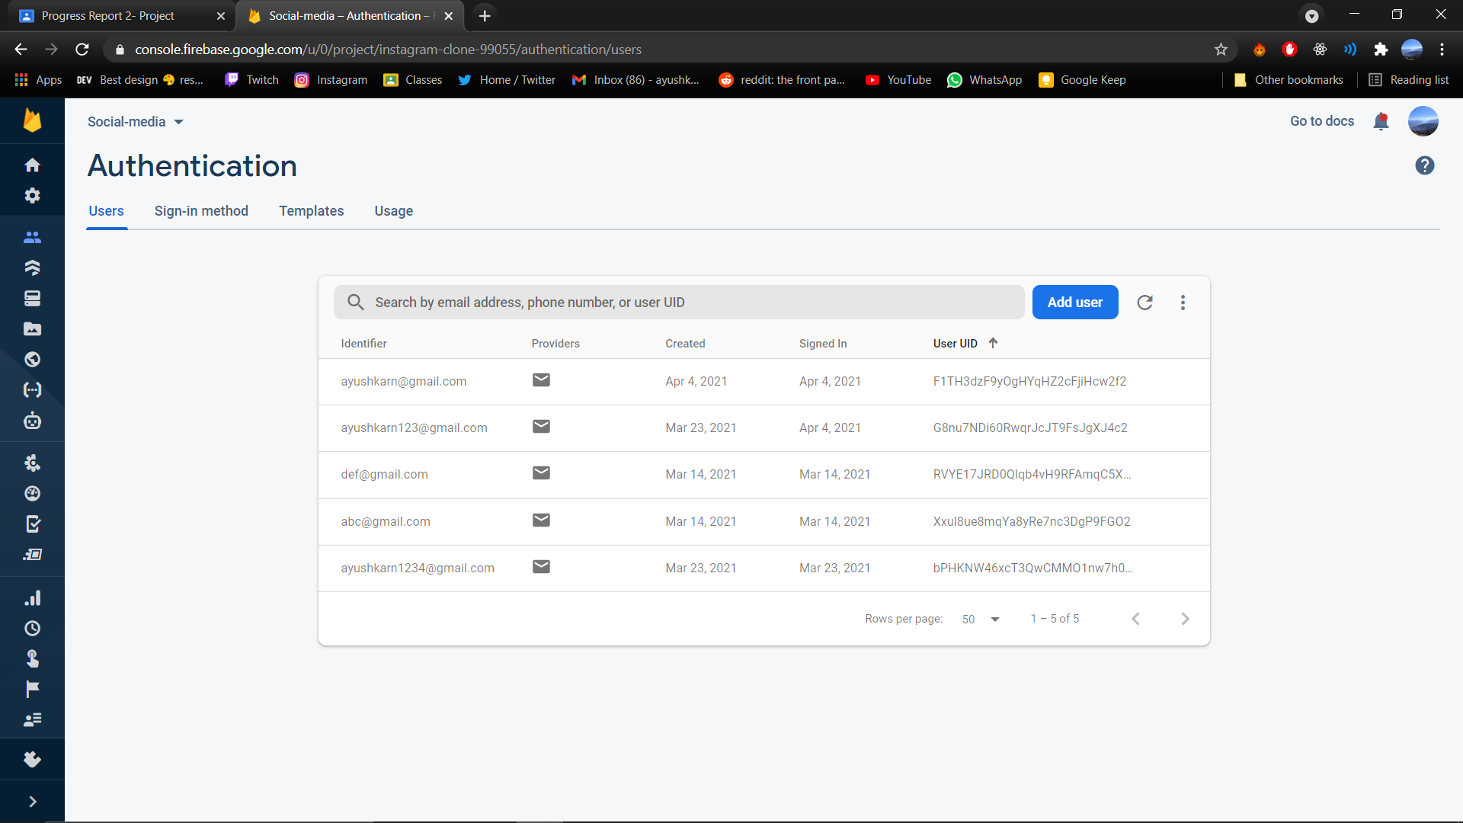
Work Done till 2nd review
Worked on the backend and firebase
Place your screenshot here
We learnt whatever was necessary to implement
The things needed for this project. We created the
Backend of this project on firebase. We also crea-
ted our database inside of the firebase and conn-
ected the website to authenticate, upload and
post images to the website.
NoSQL database of Firebase called Firestore
Was implemented
Signup and Sign-out feature was implemented

Slide 9
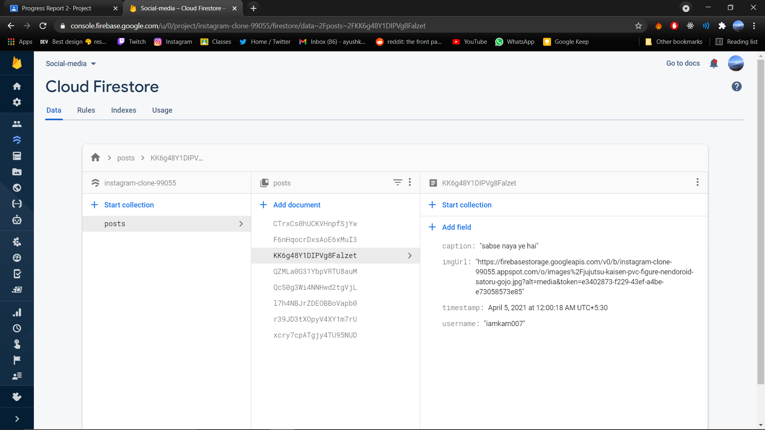
Work Done after 2nd review
Worked on the backend and firebase
Place your screenshot here
NoSQL database of Firebase called Firestore
Was implemented.
Collection of posts was made. Inside the collection
We stored our documents that included fields and
Their respective datatypes. Such as caption as text
imageURL as a URL of the image to be uploaded
Timestamp for storing date and time of the image
And username who uploaded the image
Posting the photo feature was implemented.

Slide 10
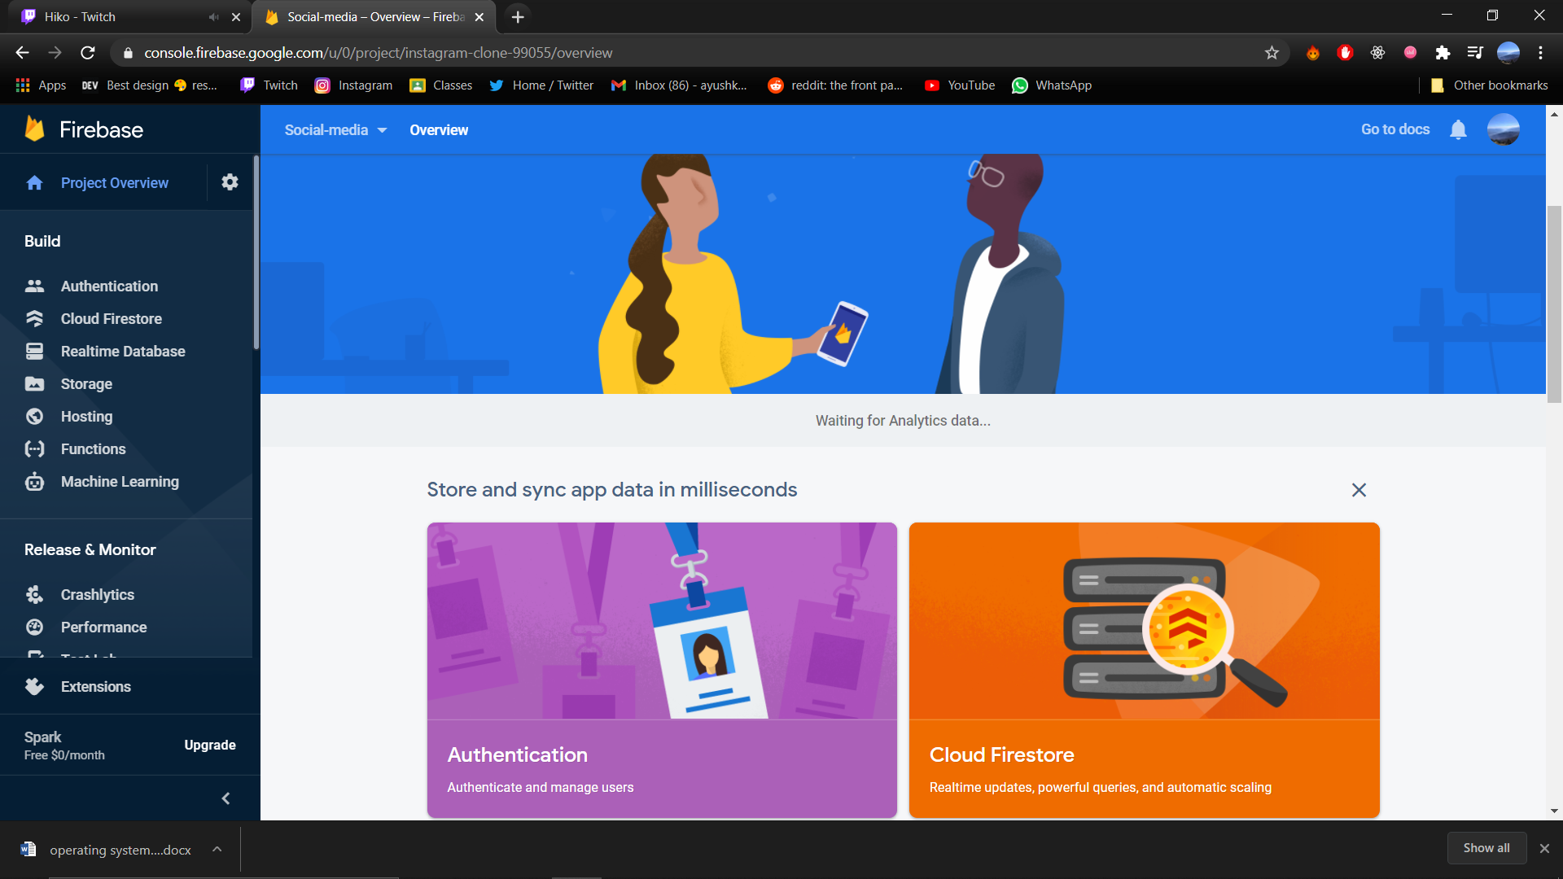
Work done after 2nd review
Completed the work on
firebase
Place your screenshot here
After 2nd review we had a website that was hosted on the local host. We planned to host the website on Google's firebase as firebase also gives us the functionality to host the website.
The post that are posted by a user was not arranged according to the timestamp as then but we worked on that feature so that posts are now arranged on the basis of time of upload

Slide 11
Firebase FIRETORE DATABASE IMPLEMENTATION
This project was implemented using Firebase as our backend to everything that includes Database Design, authentication, storing of the images on Google’s firebase server and retrieving the URL that was converted to firebase’s URL and fed directly into int Database created by us.
One of the main benefits of using React.JS as front end is because each of the things can be broken down into simple components and then be used multiple times with just one line of code and changing the values according to the need. Some of the important components are described in brief below:
<Post.js>
This is component that included everything that a Social Media post holds. It included username of the uploader, Caption if there was any, timestamp of when the post was uploaded a PostID to differentiate each post kept in the database.
<ImgUpload.js>
This component that was used to upload post inside the website and was directly connected to the backend. This component was used at the bottom of the page and by using this user could upload images to the website as well as videos and then these images were uploaded to firebase’s server and then firebase would generate a ImageURL which was stored in the database instead of the image. Using the image URL instead of the image helped us reduce the time taken, drastically and made the website more reactive.

Slide 12
Firebase FIRETORE DATABASE IMPLEMENTATION
<App.js>
This was the main component of our entire project and it is where all other components were called and used. <Post.js> , <ImgUpload.js>, <Index.js> etc. were called into this component and used multiple times as desired.
<Post.css, ImageUpload.css, App.css, etc.>
All the CSS components were used just to provide better look to the website which is very important because user interface is very much useful for a website. A website with better USX will always attract more people than with a bad USX one.

Slide 13
Database schema
We have used firebase’s Firestore Database to implement the Database for our project. It is a NoSQL based Database and contains these components inside of them.
A Collection called Post that holds all the posts that are uploaded to the website.
Each Post has following documents in them:
caption: “string” this stores the caption for that post
imgUrl: “string” ImageURL is stored in this part
timestamp: “time” Firebase’s server time is stored for ordering the posts and maintaining uniformity.
username: “string” username of the uploader is stored

Slide 14
Database schema
Each post also has another sub collection in order to store all the comments that are done on that specific post. This comment section is further divided into sub documents which are as follows:
text: “string” for storing the comment on the post.
timestamp: “time” for storing the time of uploading the comment and for ordering purpose
username: “string” for storing username of the person commenting on the post.
Along with all of these each of the document is automatically provided a DocumentID in order to be made unique and this DocumentID is used as a primary key for the database and also as a foreign key for relating to some other part of database.

Slide 15
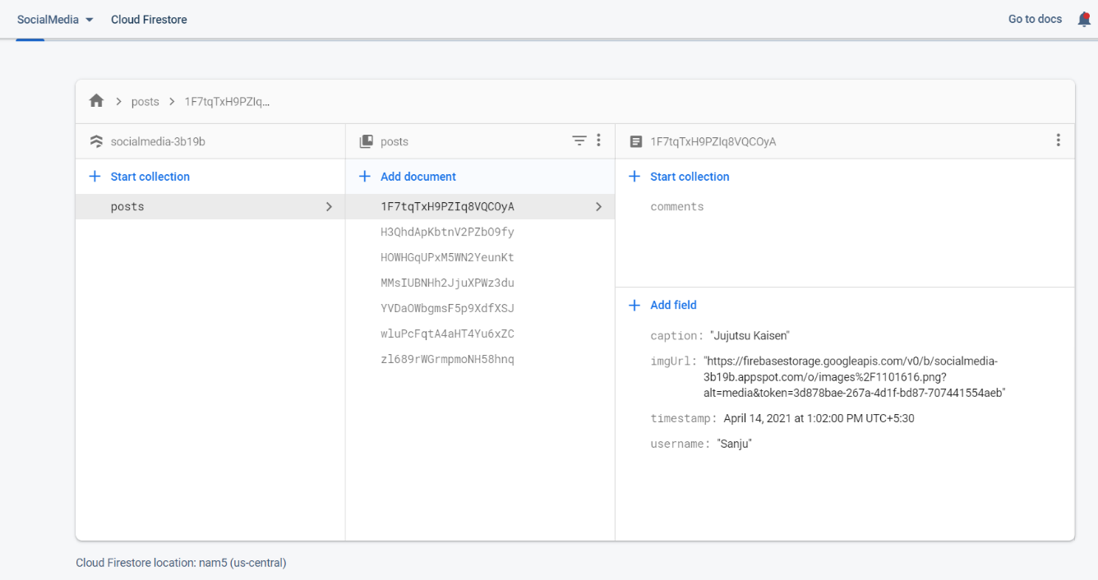
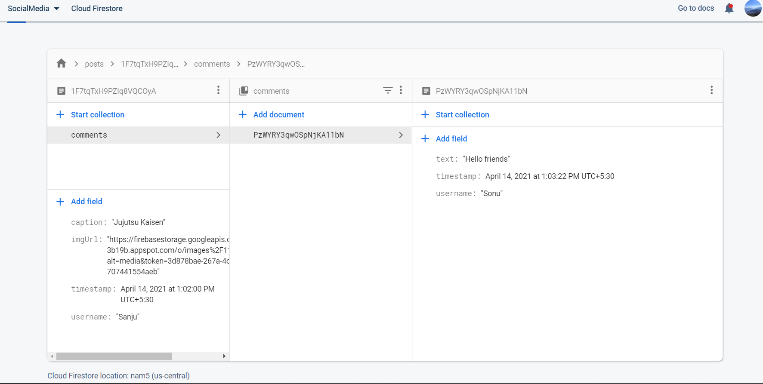
Database schema
Picture of Database inside Firebase
Place your screenshot here

Slide 16
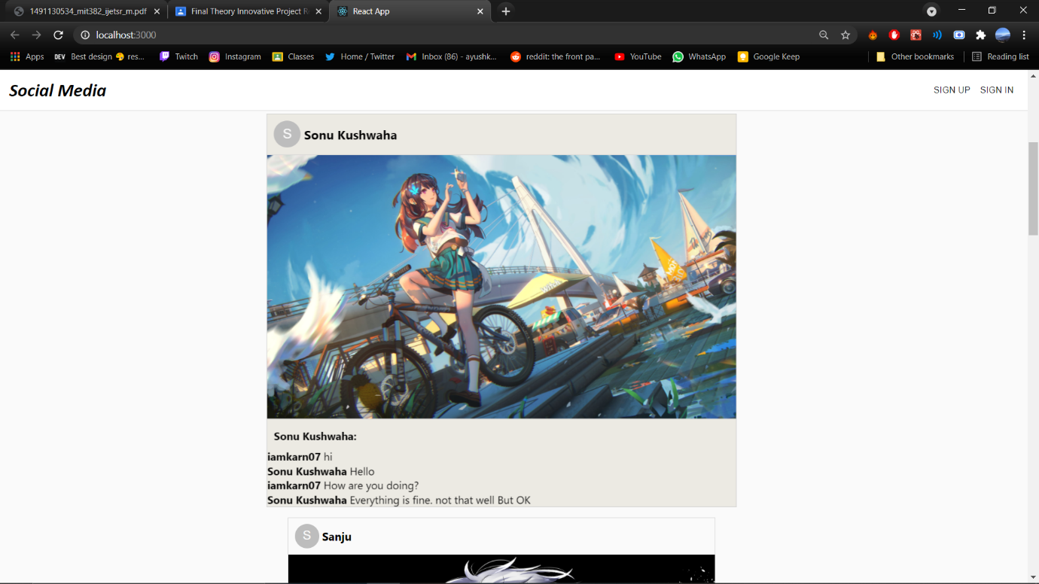
Result Conclusion and analysis
The results that we got from learning React.JS and Firebase for just 3-4 months were very promising and we definitely could learn a lot more if we had more time up our sleeves. But because we had 5 other projects to work on we couldn’t do everything that we wanted to. Some of the results screenshots are attached on the right
From this project we would like to conclude that we have actually learnt a great deal about web and I will be making a few more projects on the web development. This innovative part that was added to our curriculum could prove to be very useful in future as we are trying to learn new things on our own and self-taught things are proven to be more effective as well as more useful for a person.

Slide 17
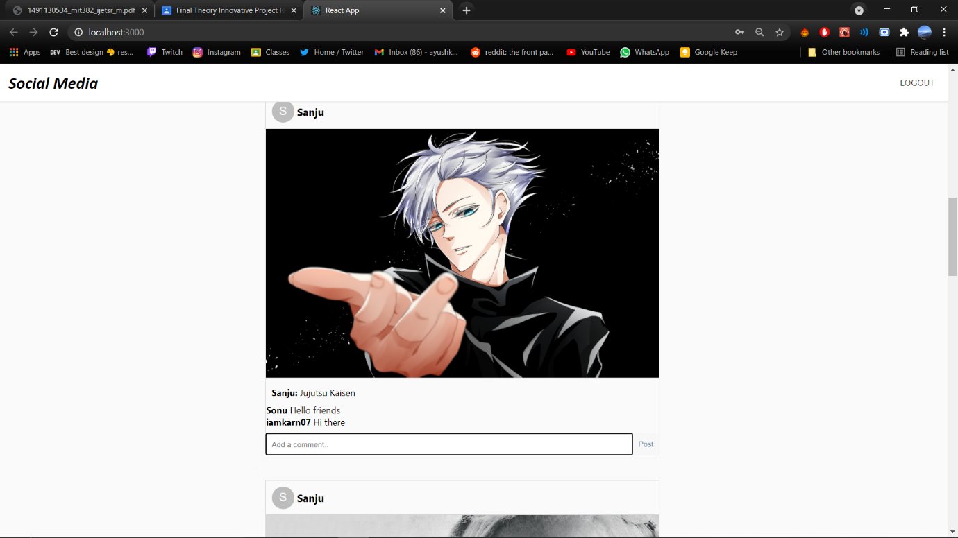
Result Conclusion and analysis
One innovative thing that we did in this project is that, by using react instead of other similar framework we saved a lot of data while browsing the website. For example: when a user comments on a post or when a user uploads a post with the help of react we are just refreshing that specific part of DOM and not the whole DOM. Because of this we don’t have to fetch everything in the database but we could just fetch the part that is recently modified or added and we can save a lot of time and processing power.
Another innovative thing that we did in this project was using URL for image instead of the actual image inside of the database. This helped us reduce the size of the database. We also used firebase compression algorithm in order to reduce the size of the image and then stored that reduced sized image with no noticeable change in quality inside Firebase and used the URL for the same inside our database.

Slide 18
REFERENCES
[1] Singh H S., Singh U. “Study on Google Firebase for Website Development (The real time database)” International Journal of Engineering Technology Science and Research, Volume 4, Issue 3 March 2017
[2] Khawas C. , Shah P. “Application of Firebase in Android App Development-A Study” International Journal of Computer Applications Volume 179(46):, June 2018
[3] Yeshwin A., Sahoo A. , Shoby P. “A Research Paper on a Pet-Friendly Application using Flutter and Firebase” International Journal for Research in Applied Science & Engineering Technology (IJRASET
)Volume 8 Issue XII Dec 2020
[4] B. Traversy, “React JS Crash Course 2021” Jan 2021. [YouTube]
[5] V. Singh “Introduction to Firebase” Medium.com Dec 2018 [Medium.com]
[6] Firebase Documentation (https://firebase.google.com/docs)

